Slide 1
Case Study
Notes:
[Welcome & introduce module facilitators]

Slide 2
Background

Slide 3
The GreenWaste Innovation Program
Government program subsidizing innovative waste management technologies
Goal: Reduce waste management costs
Policy question: Should the program be scaled up nationally?
Decision criterion: Program must reduce waste management at least 1,000 Dirham (AED)

Slide 4
The GreenWaste Innovation Program Features
Subsidies for purchasing or supporting new waste management technologies, which can include any of the following waste management upgrades:
    Additional or updated recycling bins with descriptions of which items belong into which bin.
    AI-powered recycling app subscription for employees that provides information about which materials are recyclable and allows them to take a picture or scan their trash and classifies in which bin it belongs.
    “Smart” garbage/recycling bins that use optical sensors and AI to monitor fill levels, contamination, and even automate sorting and separating of recycle-able materials from other trash.
    Sustainable production practices such as creating bio-degradable or reusable products.
    Installation/connection to pneumatic waste pipes, which are a series of underground pipes under garbage bins that eliminate the need for traditional trash pick-ups.
Technical assistance for implementation (e.g., how to get access to and install “smart” trash bins)
Training for employees (e.g., encouraging recycling by outlining the benefits, and info on which materials are recyclable)

Slide 5
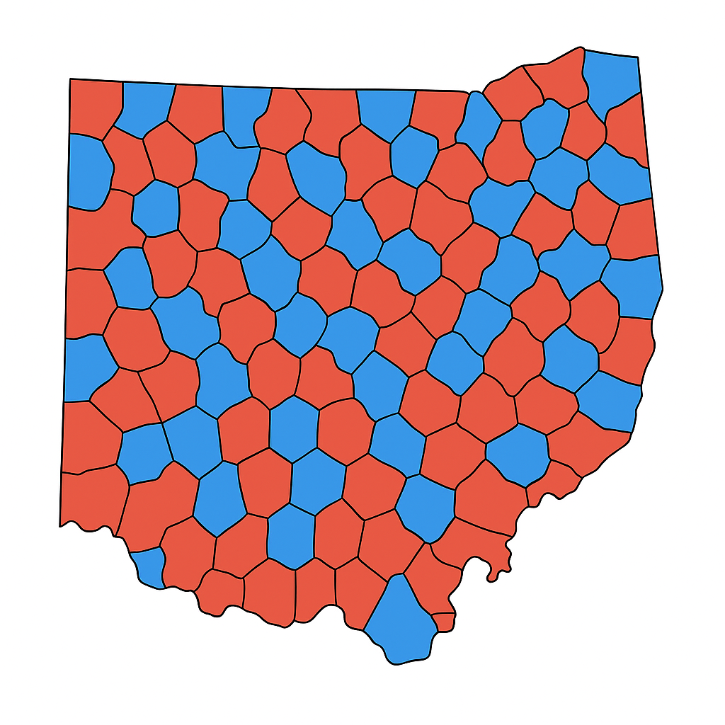
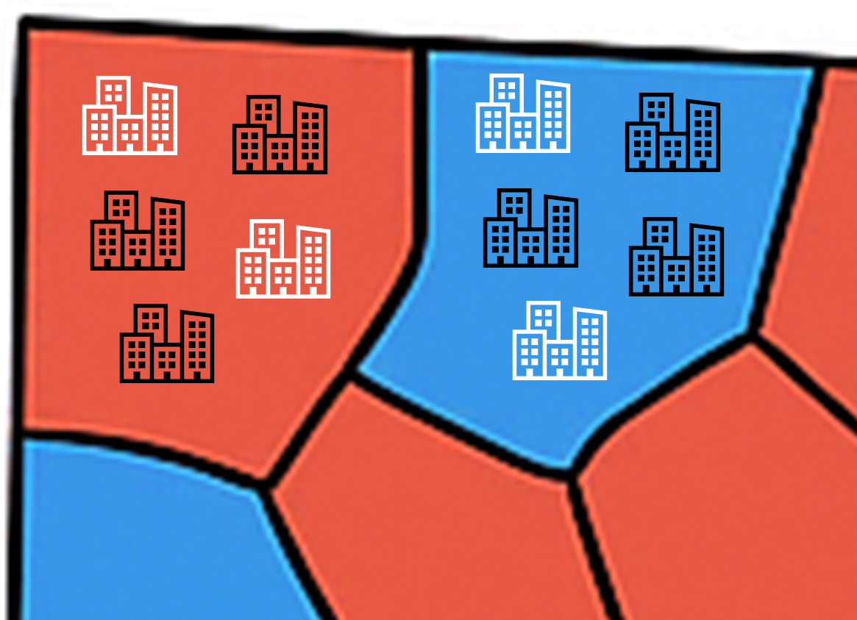


Map of the Emirate with 200 Neighborhoods
Control Neighborhoods
Treatment Neighborhoods
10 ineligible businesses
Each neighborhood has multiple eligible and ineligible businesses.
The program is only available to those in treatment neighborhoods (blue) that are also eligible (those with an efficiency score<=58).
10 eligible businesses
Notes:
Geographic Coverage:
100 treatment neighborhoods where the program was implemented (treatment_zone = 1)
100 control neighborhoods where the program was not available (treatment_zone = 0)
Eligibility Criteria:
Eligibility was determined by a waste management efficiency index, which is calculated through a proxy means test that assigned each business in the community a score between 20 and 100 based on various characteristics of the business (recycling, filtration, water treatment, proximity to recycling center, size of business).
Businesses with an efficiency_index below 58 were eligible.
The program was only available to eligible businesses in treatment neighborhoods.
Enrollment Process:
Eligible businesses in treatment neighborhoods enroll voluntarily.
Timeline:
Baseline data was collected in September 2022, before program implementation (round = 0)
Follow-up data was collected in November 2023, 12 months after implementation (round = 1)

Slide 6
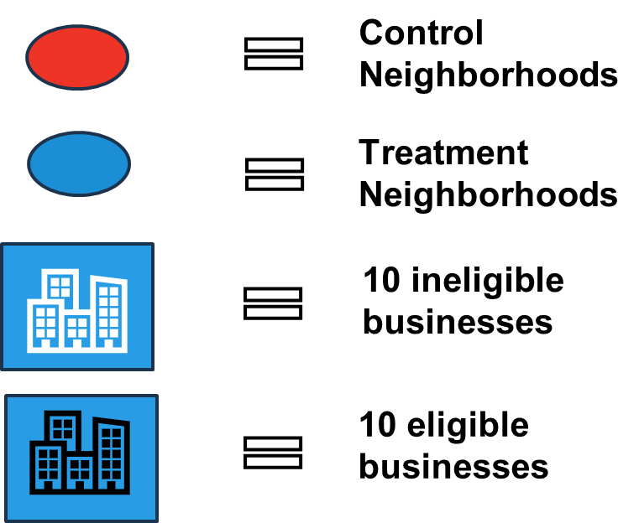
Map of the Emirate with 200 Neighborhoods
Total businesses in the Emirate | 9,913
Total businesses in treatment neighborhoods | 4,959
Total eligible businesses in treatment neighborhoods (enrolled) | 2,964
Total businesses that are ineligible in treatment neighborhoods | 1,995

Slide 7
Key Variables
Outcome Variable:
waste_management_costs: Waste managament incurred yearly per industry (Dirham)
Treatment Variables:
treatment_neighborhood: Area selected for program (0/1)
eligible: Business eligible for program (0/1)
enrolled: Business eligible and in treatment neighborhood (0/1)
Other Variables:
round: Survey round (0=baseline, 1=follow-up)
efficiency_index: Score between 20-100, calculated based on business characteristics (recycling, filtration, water treatment, proximity to recycling center)
Leadership Demographics: Age, education, gender, etc.

Slide 8
Key Variables
Other Variables:
neighborhood_identifier: Identifier for the neighborhood (200 neighborhoods in total)
business_identifier: Each neighborhood has multiple businesses (9914 businesses in our data in total)

Slide 9
Variable Name (and name in data) | Variable Description | Continuous or Indicator
Waste management costs (waste_management_costs) | Yearly waste management costs expressed in Dirham | Continuous
Neighborhood treatment status (treatment_neighborhood) | Indicator equal to 1 if neighborhood was selected for program, and 0 otherwise | Binary
Neighborhood identifier (neighborhood_identifier) | Unique numerical identifier of the neighborhood | Continuous
Business identifier (business_identifier) | Unique numerical identifier for each business | Continuous
Eligible (eligible) | Indicator equal to 1 if the business is eligible for program and 0 otherwise | Binary
Enrolled (enrolled ) | Variable equal to 1 if business is offered the program, i.e., is in a treatment neighborhood and is eligible to enroll, and 0 otherwise | Binary
Enrolled (enrolled_rp) | Variable equal to 1 if businesses actually enrolled in the program, and 0 otherwise (only for use in the IV scenario) | Binary
Survey round (round) | Variable equal to 1 in the follow-up survey and 0 at baseline | Binary
Waste management efficiency index (efficiency_index) | Value between 20-100, calculated based on various characteristics of the business, such as whether the business currently recycles, has advanced industrial filtration (if relevant to the business), a water treatment system (if relevant to the business), how far it is from a recycling center, and the size of the business. The index is calculated by assigning a score to each of these characteristics and scaling it to 100. | Continuous

Slide 10
Overview of IE Methods
Experimental Methods:
Randomized assignment (gold standard)
Quasi-Experimental Methods:
Regression Discontinuity
Difference-in-Differences
Matching Methods

Slide 11
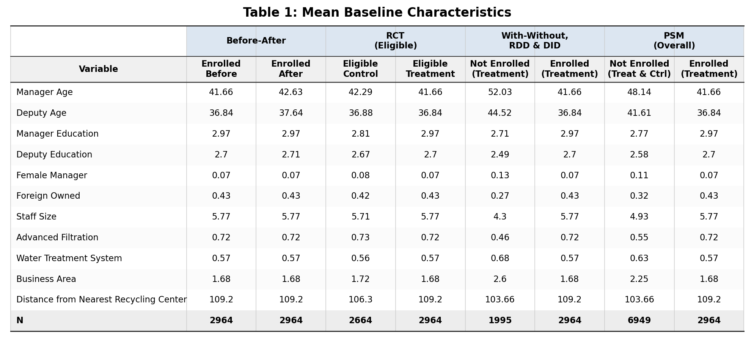
Descriptive Table
Notes:
Business area: categorical variable coded as numeric for sector/type of business
This is an assumption because it appears to be categorical ids, varies across neighborhoods (there are many neighborhoods and businesses with diff business types) but is consistent within the same business ID (same business has same type)
Water treatment system: whether businesses has a water treatment system (0/1), or in other words, treats/removes waste-related wastewater on-site.
Advanced filtration: whether businesses has an advanced waste sorting/filtration system in place (0/1). This means equipment or processes that filter/sort contaminants and separate recyclable materials from mixed waste more effectively than standard bins. Exact technology may vary but examples could include on-site sorting/filtration units or smart/optical separation.

Slide 12
Descriptive Table (editable)
 | Before-After Means |  | Eligible Units Means (RCT) |  | Eligible Enrollment Units Means (IV) |  | Treatment Offered Units Means (With-Without, RDD, DID) |  | Overall Offered Means (PSM)
Variable | Offered Treat Before | Offered Treat After | Eligible Control | Eligible Treatment | Eligible Not Enrolled | Eligible Enrolled | Not Offered Treatment | Offered Treatment | Not Offered (Treat and Control) | Offered Treatment
Advanced Filtration | 0.72 | 0.72 | 0.73 | 0.72 | 0.74 | 0.72 | 0.46 | 0.72 | 0.55 | 0.72
Deputy Age | 36.84 | 37.64 | 36.88 | 36.84 | 36.91 | 36.81 | 44.52 | 36.84 | 41.61 | 36.84
Manager Age | 41.66 | 42.63 | 42.29 | 41.66 | 42.33 | 41.61 | 52.03 | 41.66 | 48.14 | 41.66
Business Area | 1.68 | 1.68 | 1.72 | 1.68 | 1.73 | 1.67 | 2.60 | 1.68 | 2.25 | 1.68
Deputy Education | 2.70 | 2.71 | 2.67 | 2.70 | 2.67 | 2.71 | 2.49 | 2.70 | 2.58 | 2.70
Manager Education | 2.97 | 2.97 | 2.81 | 2.97 | 2.82 | 2.97 | 2.71 | 2.97 | 2.77 | 2.97
Female Manager | 0.07 | 0.07 | 0.08 | 0.07 | 0.08 | 0.07 | 0.13 | 0.07 | 0.11 | 0.07
Foreign Owned | 0.43 | 0.43 | 0.42 | 0.43 | 0.42 | 0.43 | 0.27 | 0.43 | 0.32 | 0.43
Distance from Nearest Recycling Center | 109.20 | 109.22 | 106.30 | 109.20 | 106.56 | 109.01 | 103.66 | 109.20 | 103.66 | 109.20
Staff Size | 5.77 | 5.77 | 5.71 | 5.77 | 5.71 | 5.78 | 4.30 | 5.77 | 4.93 | 5.77
Water Treatment System | 0.57 | 0.57 | 0.56 | 0.57 | 0.55 | 0.58 | 0.68 | 0.57 | 0.63 | 0.57
N | 2,964.00 | 2,964.00 | 2,664.00 | 2,964.00 | 2,721.00 | 2,907.00 | 1,995.00 | 2,964.00 | 6,949.00 | 2,964.00

Slide 13
Background
Emirate (N=9913)
Treatment Neighborhoods (N=4959)
Control Neighborhoods (N=4954)
Eligible Businesses (N=2964)
Ineligible Businesses (N=1995)
Eligible Businesses (N=2664)
Ineligible Businesses (N=2290)
Eligible businesses are those with efficiency_index<=58

Slide 14
Background
Emirate (N=9913)
Treatment Neighborhoods (N=4959)
Control Neighborhoods (N=4954)
Eligible Businesses (N=2964)
Ineligible Businesses (N=1995)
Eligible Businesses (N=2664)
Ineligible Businesses (N=2290)
PSM is Eligible vs. All Others
Enrolled vs. Not Enrolled, RD, DID
RCT
Eligible businesses are those with efficiency_index<=58

Slide 15
Exercise 1-2

Slide 16
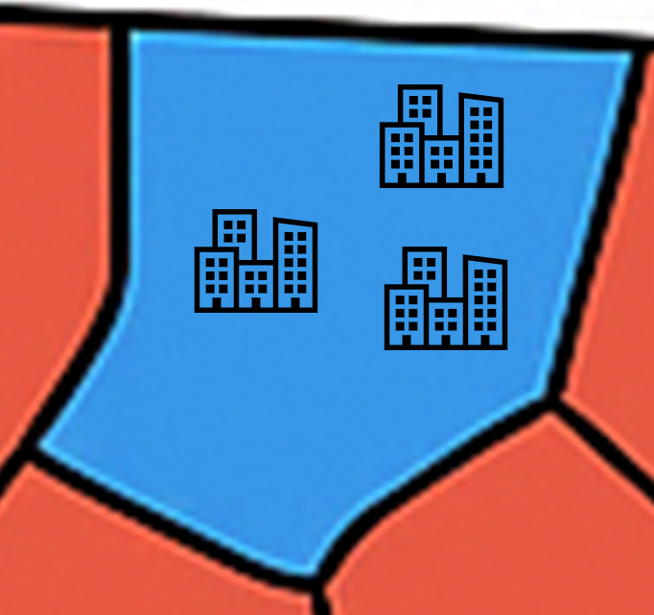
Eligible Businesses in Treat Neighborhoods
Total businesses in the Emirate | 9,913
Total businesses in treatment neighborhoods | 4,959
Total eligible businesses in treatment neighborhoods (enrolled) | 2,964
Control Neighborhoods
Treatment Neighborhoods
10 eligible businesses

Slide 17
Before-After

Slide 18
Before-After (editable)
Table 1: Before-After Results
 | Before-After
Before vs. After Effect | -664.9***
 | (23.002)
(Intercept) | 1448.969***
 | (14.596)
Num.Obs. | 5928
+ p < 0.1, * p < 0.05, ** p < 0.01, *** p < 0.001
Standard errors are in parentheses

Slide 19
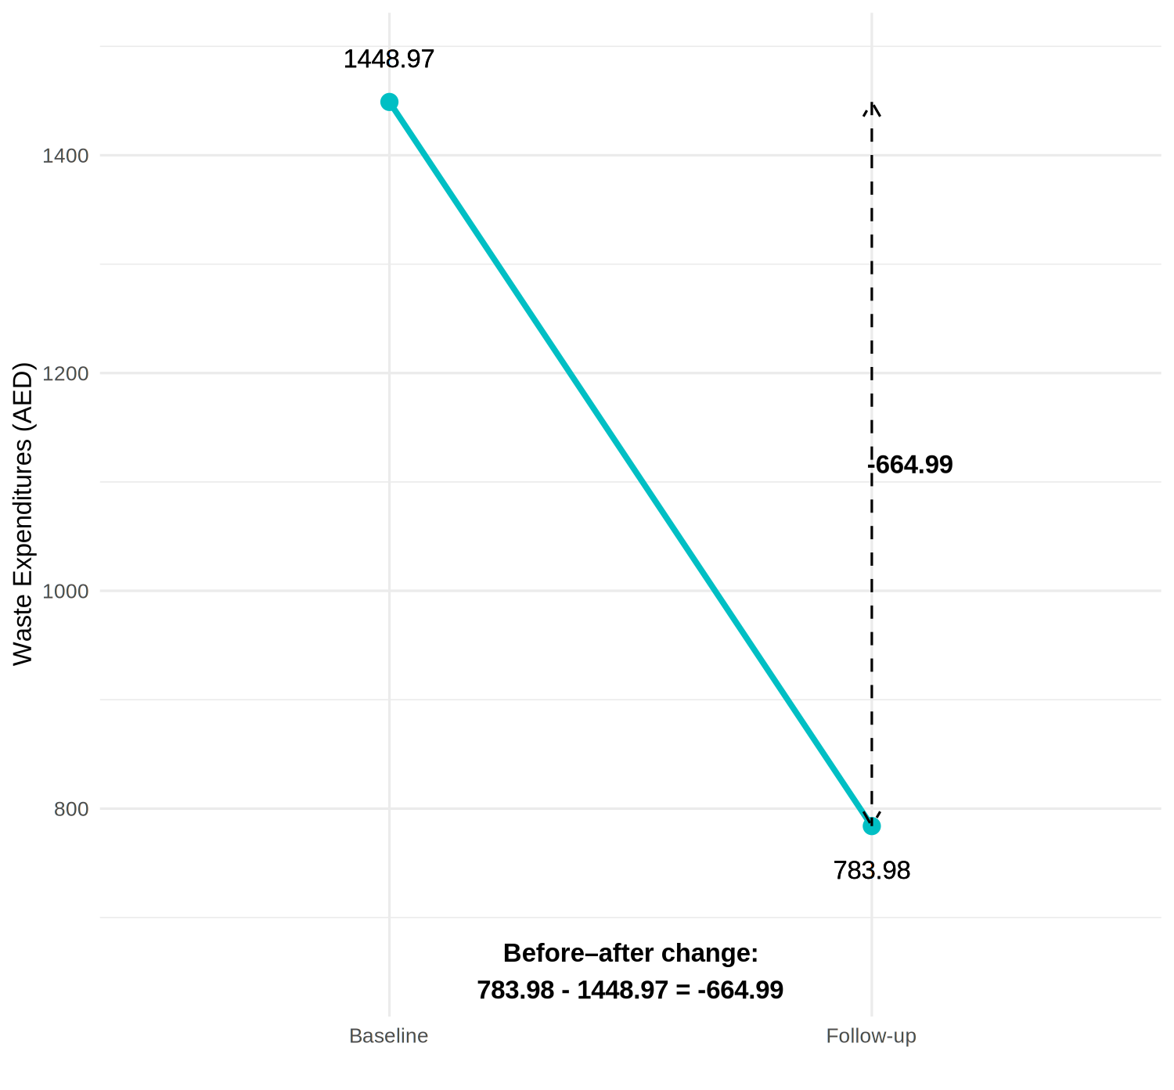
Before-After Graph

Slide 20
Enrolled vs. Not Enrolled in Treat Neighborhoods
Total businesses in the Emirate | 9,913
Total businesses in treatment neighborhoods | 4,959
Total eligible businesses in treatment neighborhoods (enrolled) | 2,964
Total businesses that are ineligible in treatment neighborhoods | 1,995
Control Neighborhoods
Treatment Neighborhoods
10 ineligible businesses
10 eligible businesses

Slide 21
Enrolled vs. Not Enrolled in Treat Neighborhoods
Total businesses in the Emirate | 9,913
Total businesses in treatment neighborhoods | 4,959
Total eligible businesses in treatment neighborhoods (enrolled) | 2,964
Total businesses that are ineligible in treatment neighborhoods | 1,995
Control Neighborhoods
Treatment Neighborhoods
10 ineligible businesses
10 eligible businesses

Slide 22
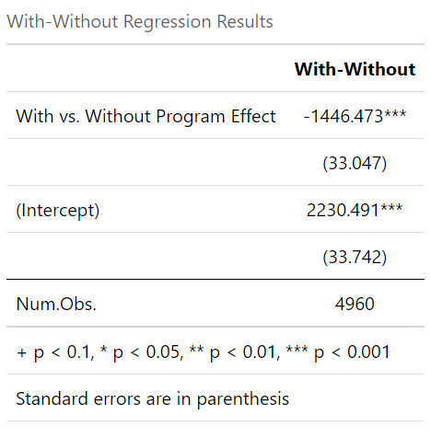
Enrolled vs. Not Enrolled

Slide 23
Enrolled vs. Not Enrolled (editable)
 | Enrolled vs. Not Enrolled
Enrolled vs. Not-Enrolled Effect | -1446.51***
 | (33.04)
(Intercept) | 2230.49***
 | (33.74)
Num.Obs. | 4959
+ p < 0.1, * p < 0.05, ** p < 0.01, *** p < 0.001
Standard errors are in parentheses

Slide 24
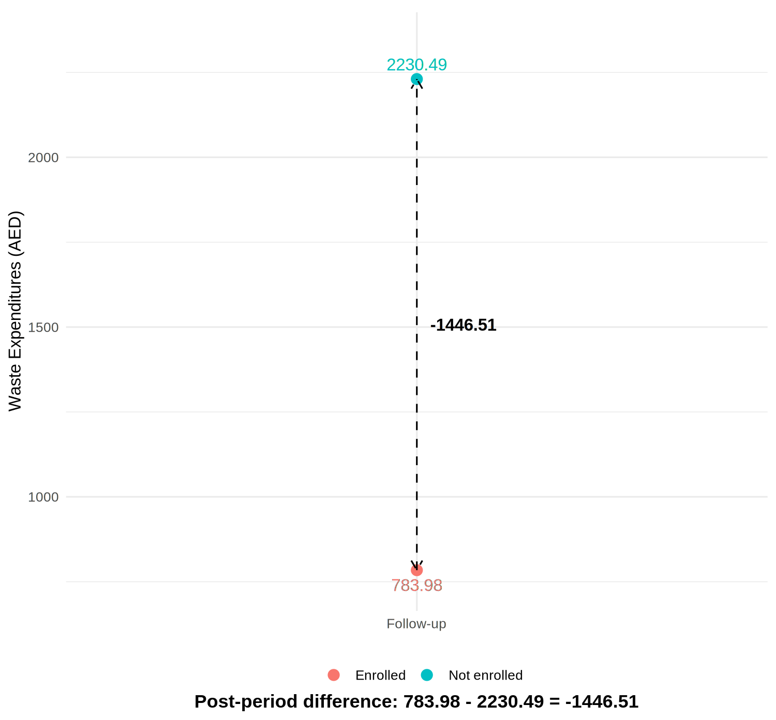
Enrolled vs. Not Enrolled Graph

Slide 25
Exercise 3: RCT

Slide 26

Compare eligible in treat vs. eligible in control (RCT)
Total businesses in the Emirate | 9,913
Total eligible businesses across all neighborhoods | 5,628
Total eligible businesses in treatment neighborhoods | 2,964
Total eligible businesses in control neighborhoods | 2,664
10 eligible businesses in control
10 eligible businesses in treatment
Notes:
For the RCT, we compare the eligible businesses within randomly assigned treatment neighborhoods to the eligible businesses within the randomly assigned control neighborhoods

Slide 27
Compare eligible in treat vs. eligible in control (RCT)
Total businesses in the Emirate | 9,913
Total eligible businesses across all neighborhoods | 5,628
Total eligible businesses in treatment neighborhoods | 2,964
Total eligible businesses in control neighborhoods | 2,664
10 ineligible businesses in control
10 eligible businesses in control
10 ineligible businesses in treatment
10 eligible businesses in treatment
Notes:
For the RCT, we compare the eligible businesses within randomly assigned treatment neighborhoods to the eligible businesses within the randomly assigned control neighborhoods

Slide 28
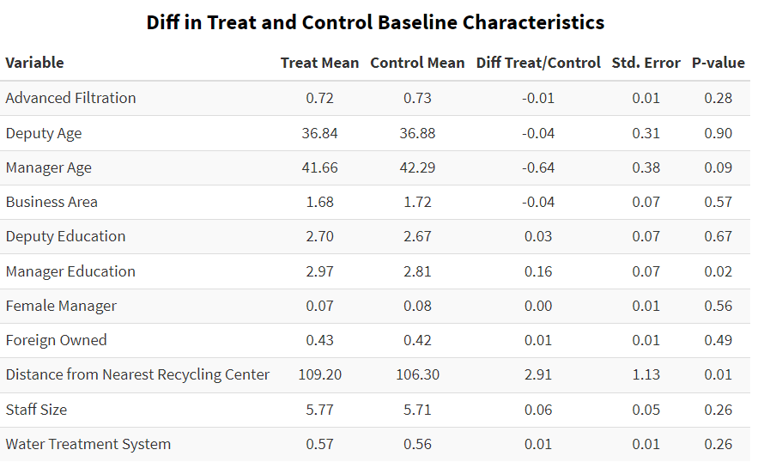
Randomization: Baseline Balance Checks

Slide 29
Baseline Check (editable)
Variable | Treat Mean | Control Mean | Diff Treat/Control | Std. Error | P-val
Advanced Filtration | 0.72 | 0.73 | -0.01 | 0.01 | 0.28
Deputy Age | 36.84 | 36.88 | -0.04 | 0.31 | 0.90
Manager Age | 41.66 | 42.29 | -0.64 | 0.38 | 0.09
Deputy Education | 2.70 | 2.67 | 0.03 | 0.07 | 0.67
Manager Education | 2.97 | 2.81 | 0.16 | 0.07 | 0.02
Business Area | 1.68 | 1.72 | -0.04 | 0.07 | 0.57
Female Manager | 0.07 | 0.08 | 0.00 | 0.01 | 0.56
Foreign Owned | 0.43 | 0.42 | 0.01 | 0.01 | 0.49
Distance from Nearest Recycling Center | 109.20 | 106.30 | 2.91 | 1.13 | 0.01
Staff Size | 5.77 | 5.71 | 0.06 | 0.05 | 0.26
Water Treatment System | 0.57 | 0.56 | 0.01 | 0.01 | 0.26

Slide 30
Baseline Check (editable)
Variable | Treat Mean | Control Mean | Diff Treat/Control | Std. Error | P-val
Advanced Filtration | 0.72 | 0.73 | -0.01 | 0.01 | 0.28
Deputy Age | 36.84 | 36.88 | -0.04 | 0.31 | 0.90
Manager Age | 41.66 | 42.29 | -0.64 | 0.38 | 0.09
Deputy Education | 2.70 | 2.67 | 0.03 | 0.07 | 0.67
Manager Education | 2.97 | 2.81 | 0.16 | 0.07 | 0.02
Business Area | 1.68 | 1.72 | -0.04 | 0.07 | 0.57
Female Manager | 0.07 | 0.08 | 0.00 | 0.01 | 0.56
Foreign Owned | 0.43 | 0.42 | 0.01 | 0.01 | 0.49
Distance from Nearest Recycling Center | 109.20 | 106.30 | 2.91 | 1.13 | 0.01
Staff Size | 5.77 | 5.71 | 0.06 | 0.05 | 0.26
Water Treatment System | 0.57 | 0.56 | 0.01 | 0.01 | 0.26

Slide 31
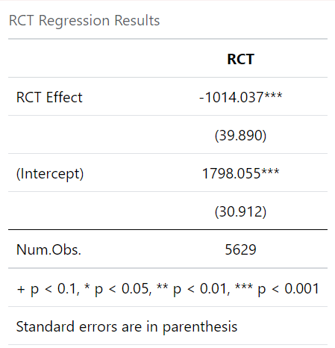
Randomization

Slide 32
Randomization (editable)
 | RCT
RCT Effect | -1014.08***
 | (39.89)
(Intercept) | 1798.06***
 | (30.91)
Num.Obs. | 5628
+ p < 0.1, * p < 0.05, ** p < 0.01, *** p < 0.001
Standard errors are in parentheses

Slide 33
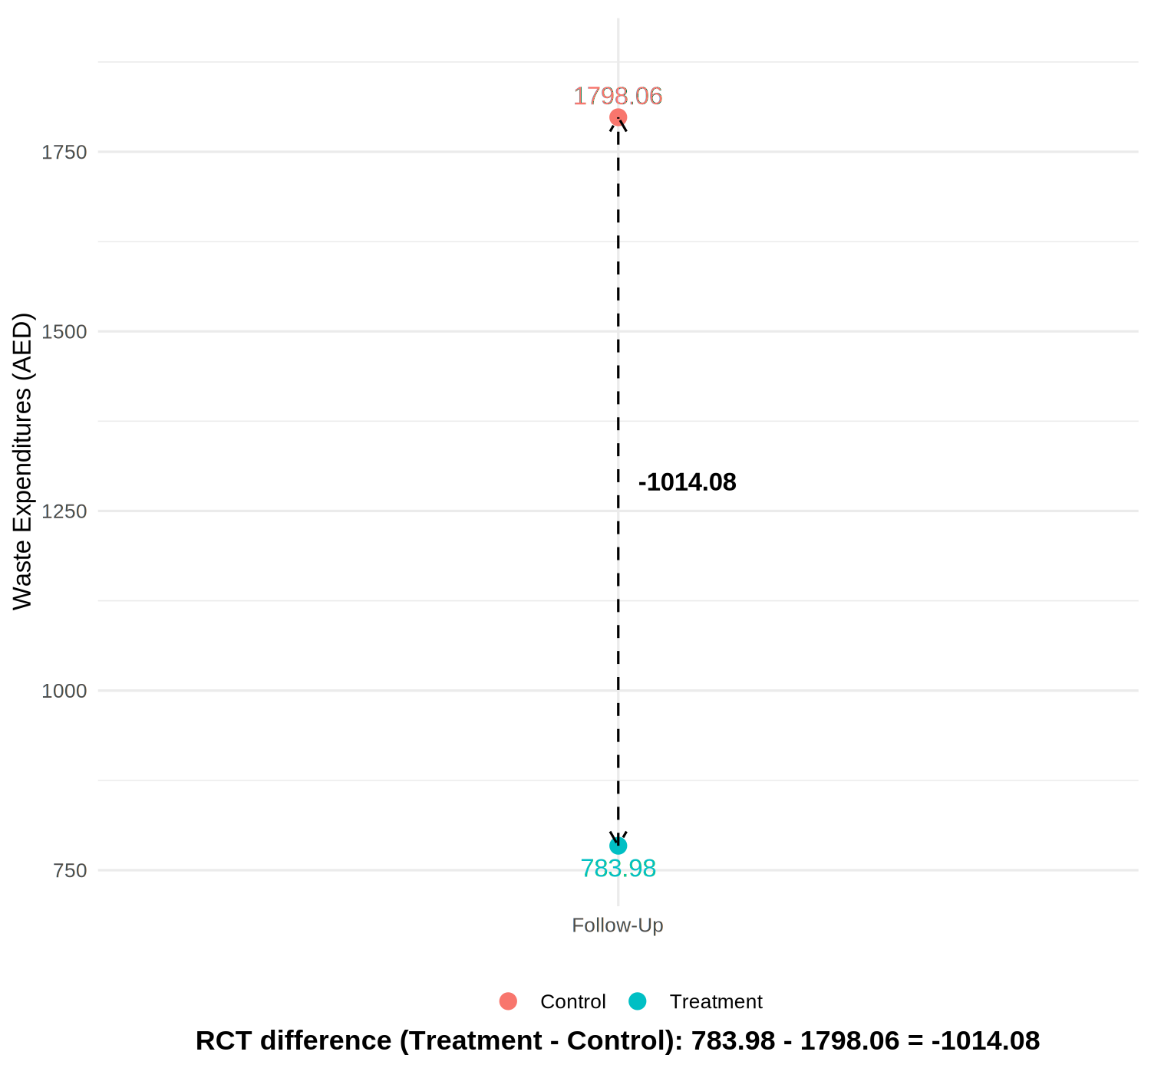
RCT Graph

Slide 34
Exercise 4: RDD

Slide 35
Enrolled vs. Not Enrolled in Treat Neighborhoods
Total businesses in the Emirate | 9,913
Total businesses in treatment neighborhoods | 4,959
Total eligible businesses in treatment neighborhoods (enrolled) | 2,964
Total businesses that are ineligible in treatment neighborhoods | 1,995
Control Neighborhoods
Treatment Neighborhoods
10 ineligible businesses
10 eligible businesses

Slide 36
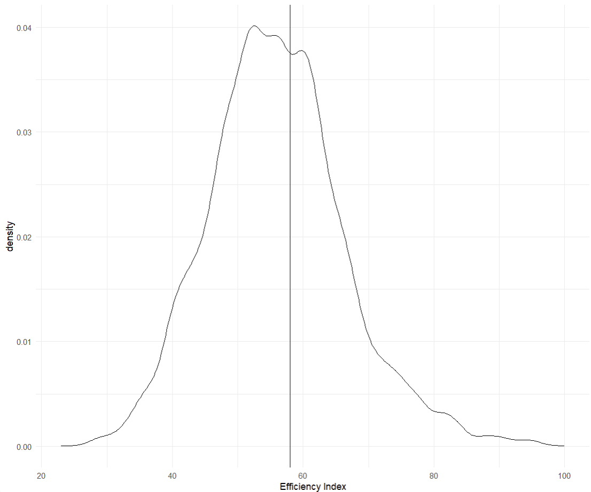
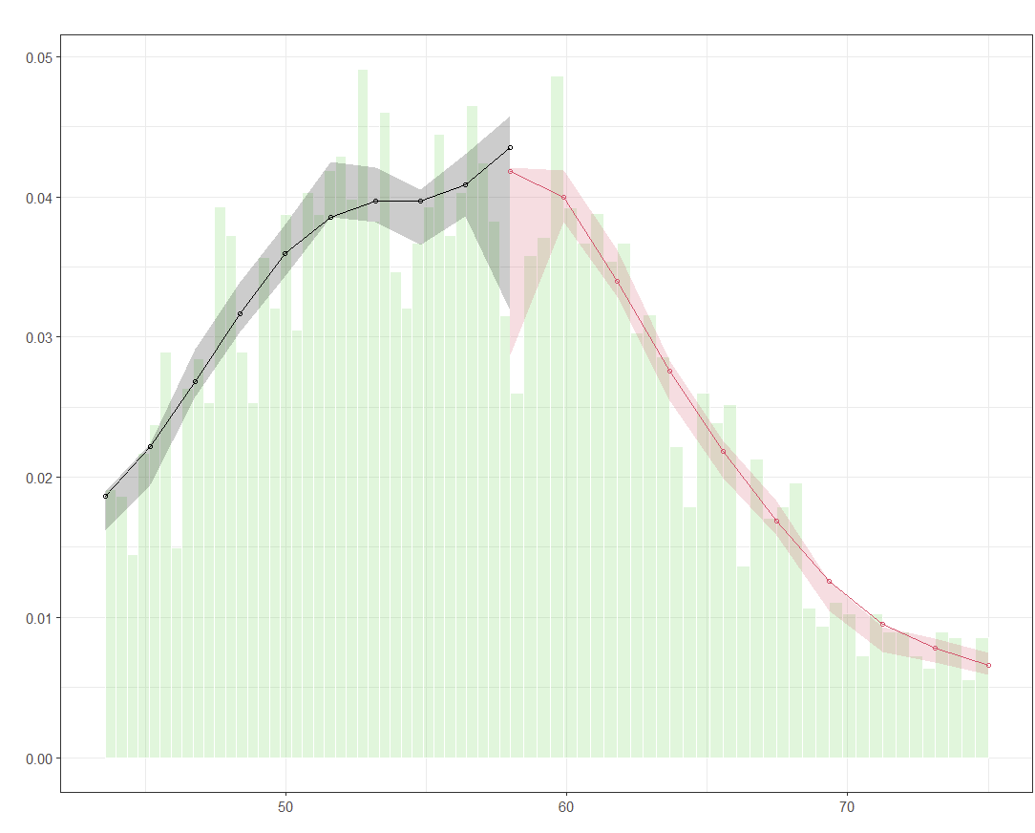
RDD Graphs: Manipulation Checks
Notes:
- No evidence of "bunching" just below cutoff- Formal McCrary density test confirms- Households do not appear to manipulate their scores

Slide 37
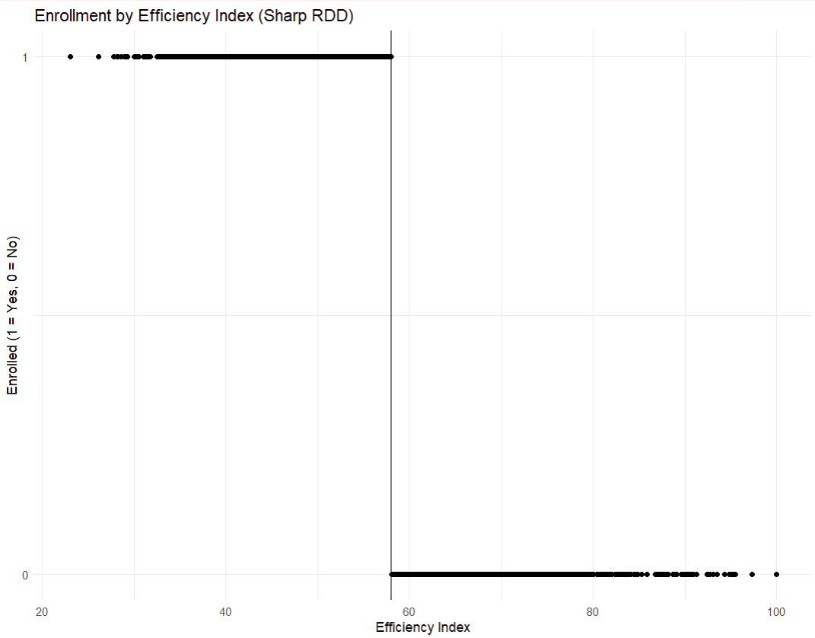
RDD Graphs: Compliance Verification

Slide 38
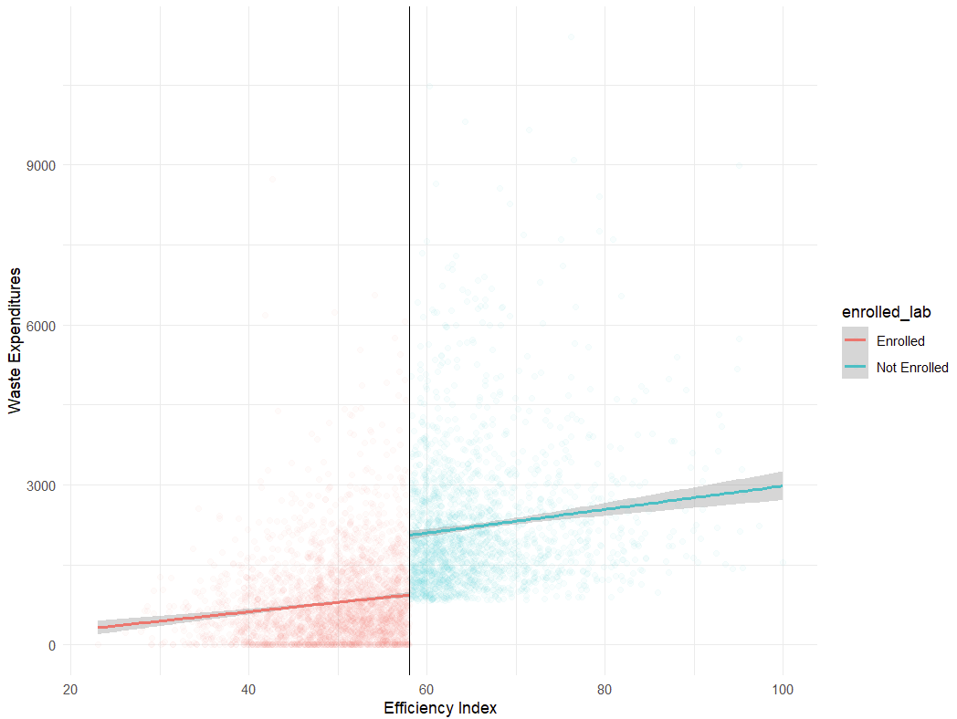
RDD Graphs: Visualization of Relationship
Notes:
- Clear discontinuity at cutoff (58)- Waste expenditures jump higher above the threshold- Linear relationship within each group- Visual evidence of program impact

Slide 39
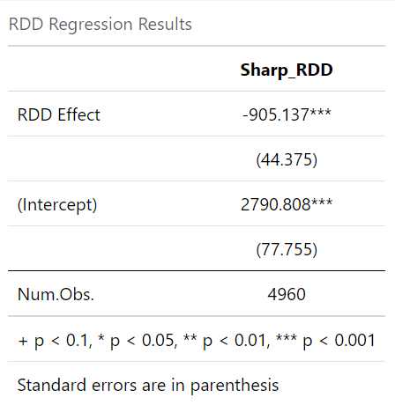
RDD

Slide 40
RDD (editable)
 | Sharp RDD (no covariates) | Sharp RDD (with covariates)
RDD Effect | -1119.07*** | -905.96***
 | (48.93) | (44.38)
(Intercept) | 2055.45*** | 2790.85***
 | (41.15) | (77.76)
Num.Obs. | 4959 | 4959
+ p < 0.1, * p < 0.05, ** p < 0.01, *** p < 0.001
Standard errors are in parentheses

Slide 41
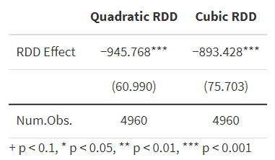
RDD Robustness
Notes:
- RDD estimates are robust across different specifications- Effect is statistically significant but below the $10,000 threshold- Results are similar to the IV estimates

Slide 42
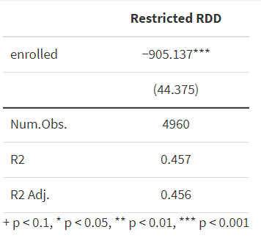
RDD Restricted to Cutoff

Slide 43
Exercise 5: DID

Slide 44
Enrolled vs. Not Enrolled in Treat Neighborhoods
Total businesses in the Emirate | 9,913
Total businesses in treatment neighborhoods | 4,959
Total eligible businesses in treatment neighborhoods (enrolled) | 2,964
Total businesses that are ineligible in treatment neighborhoods | 1,995
Control Neighborhoods
Treatment Neighborhoods
10 ineligible businesses
10 eligible businesses

Slide 45
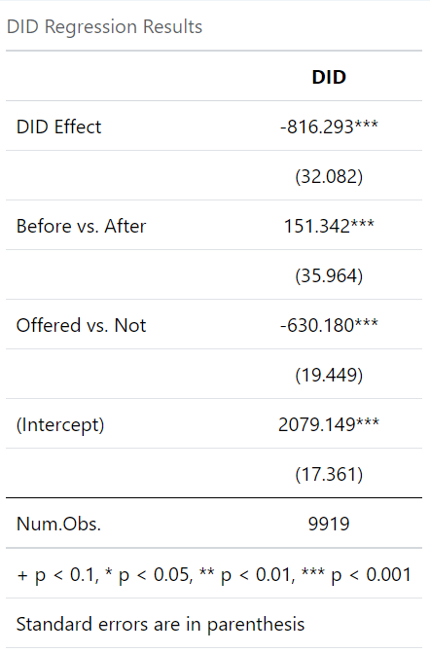
DID Results
Notes:
Enrolled vs not enrolled in treat neighborhoods
- Initial difference: Enrolled industries spent $`r round (abs(out_did$coefficients[3]),1)` less at baseline- Time trend: Non-enrolled industries increased spending by $`r round (out_did$coefficients[2],1)`- **Treatment effect**: Program reduced expenditures by $`r round (abs(out_did$coefficients[4]),1)`- Result is statistically significant but below the $10,000 threshold

Slide 46
DID (editable)
 | DID
DID Effect | -816.33***
 | (32.08)
Before vs. After | 151.34***
 | (35.96)
Enrolled vs. Not | -630.18***
 | (19.45)
(Intercept) | 2079.15***
 | (17.36)
Num.Obs. | 9918
+ p < 0.1, * p < 0.05, ** p < 0.01, *** p < 0.001
Standard errors are in parentheses
DID Regression Results

Slide 47
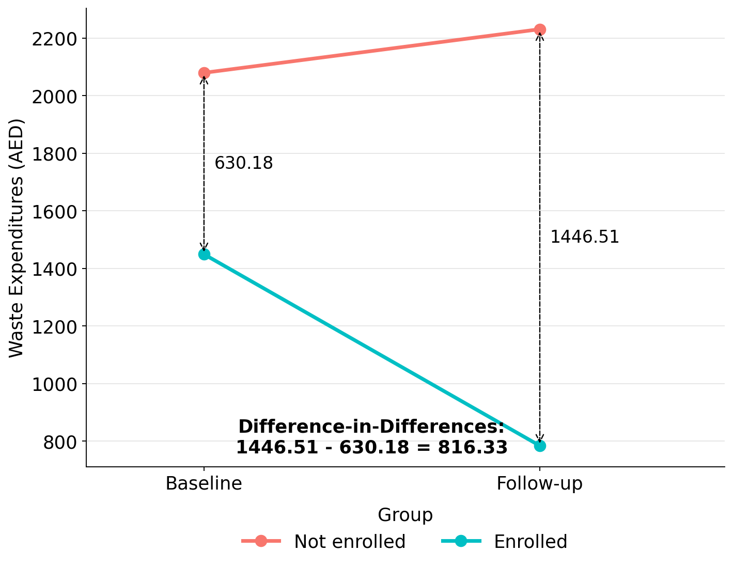
DID Graph
Notes:
- We compare changes in waste expenditures for enrolled vs. non-enrolled industries- Both groups are in treatment zones (where the program was offered)- We have data for two periods: before and after the program implementation- DiD can help address selection bias if trends would be parallel without the program

Slide 48
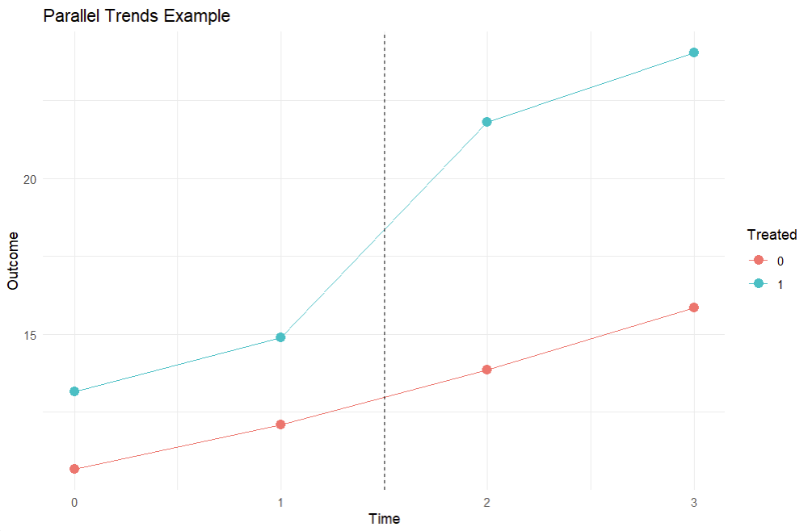
DID: Parallel Trends Check

Slide 49
Propensity Score Matching

Slide 50
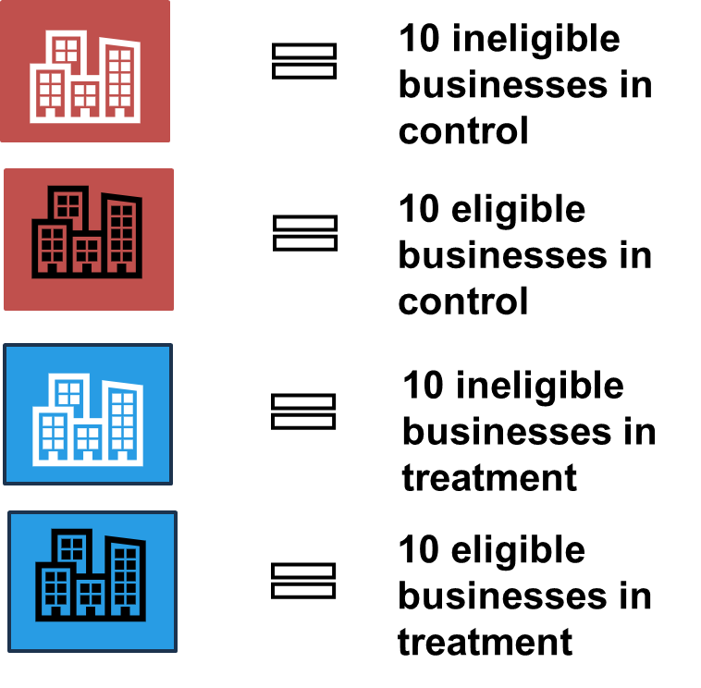
Enrolled vs. Not Enrolled Across Emirate (Before Matching)
Total businesses in the Emirate | 9,913
Total businesses in treatment neighborhoods | 4,959
Total eligible businesses in treatment neighborhoods (enrolled) | 2,964
Total businesses ineligible or in control neighborhoods (for PSM weights) | 6,949
Notes:
Enrolled vs not enrolled - in treat neighborhoods (2,965) vs. all other neighborhoods (6,949)

Slide 51
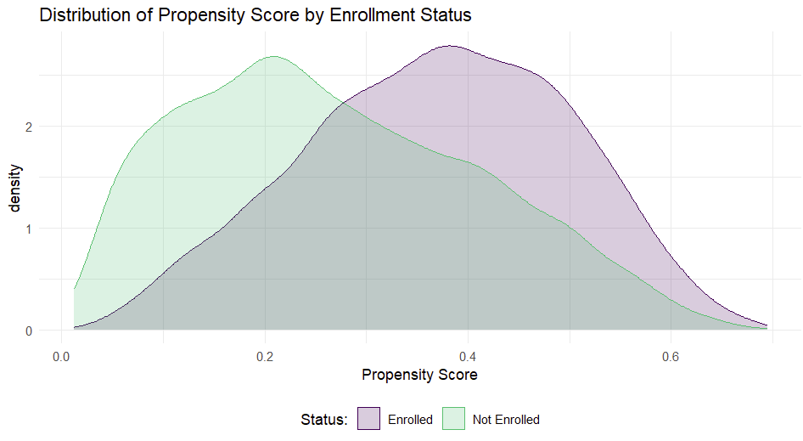
Matching Common Support
Notes:
**Common support** = overlap in propensity scores between groups- Essential for valid comparisons- Without common support, we can't find comparable units

Slide 52
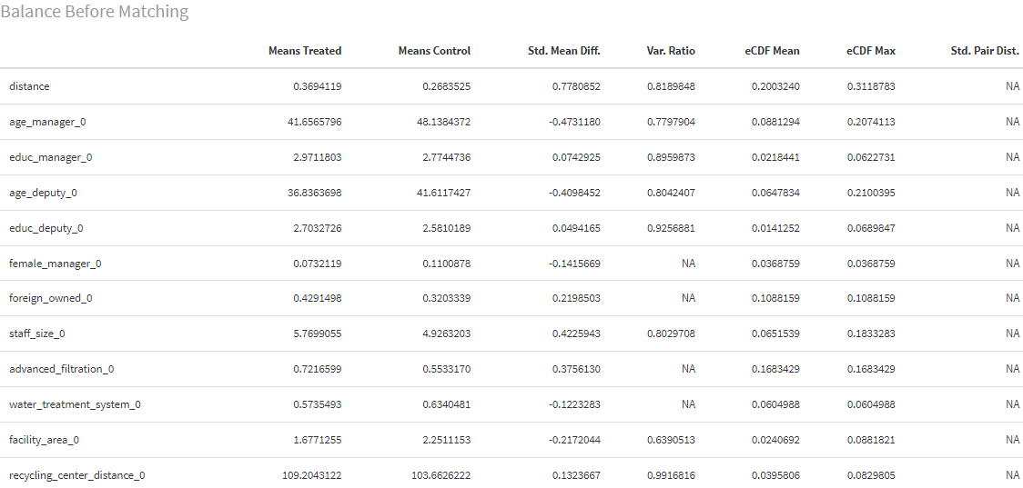
Matching: Balance Before

Slide 53
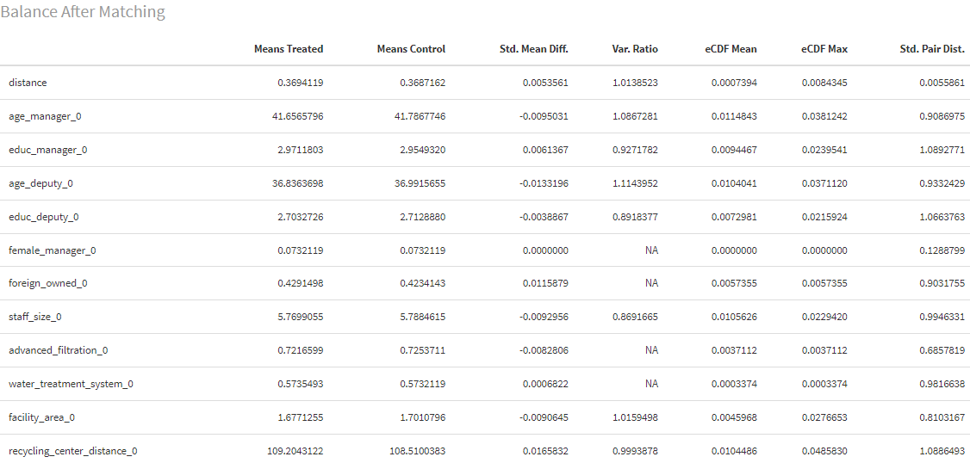
Matching: Balance After
Notes:
- **Mean Diff** should be closer to zero after matching- Standardized mean differences (not shown) should be < 0.25- Good balance ensures we're comparing similar facilities

Slide 54
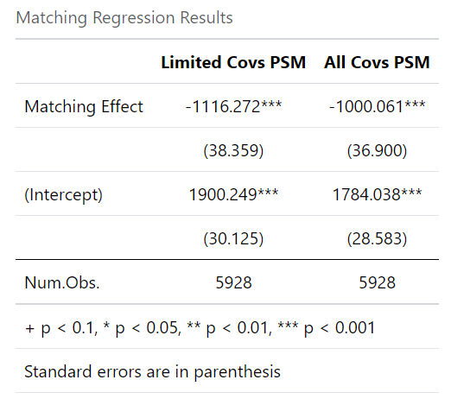
Matching
Notes:
Enrolled vs. not across all of Emirate, after weights from PSM

Slide 55
Matching (editable)
 | Limited Covs PSM | All Covs PSM
Matching Effect | -1114.80*** | -1000.05***
 | (38.50) | (35.11)
(Intercept) | 1883.33*** | 1771.27***
 | (30.54) | (27.94)
Num.Obs. | 5186 | 4888
+ p < 0.1, * p < 0.05, ** p < 0.01, *** p < 0.001
Standard errors are in parentheses
Matching Regression Results

Slide 56
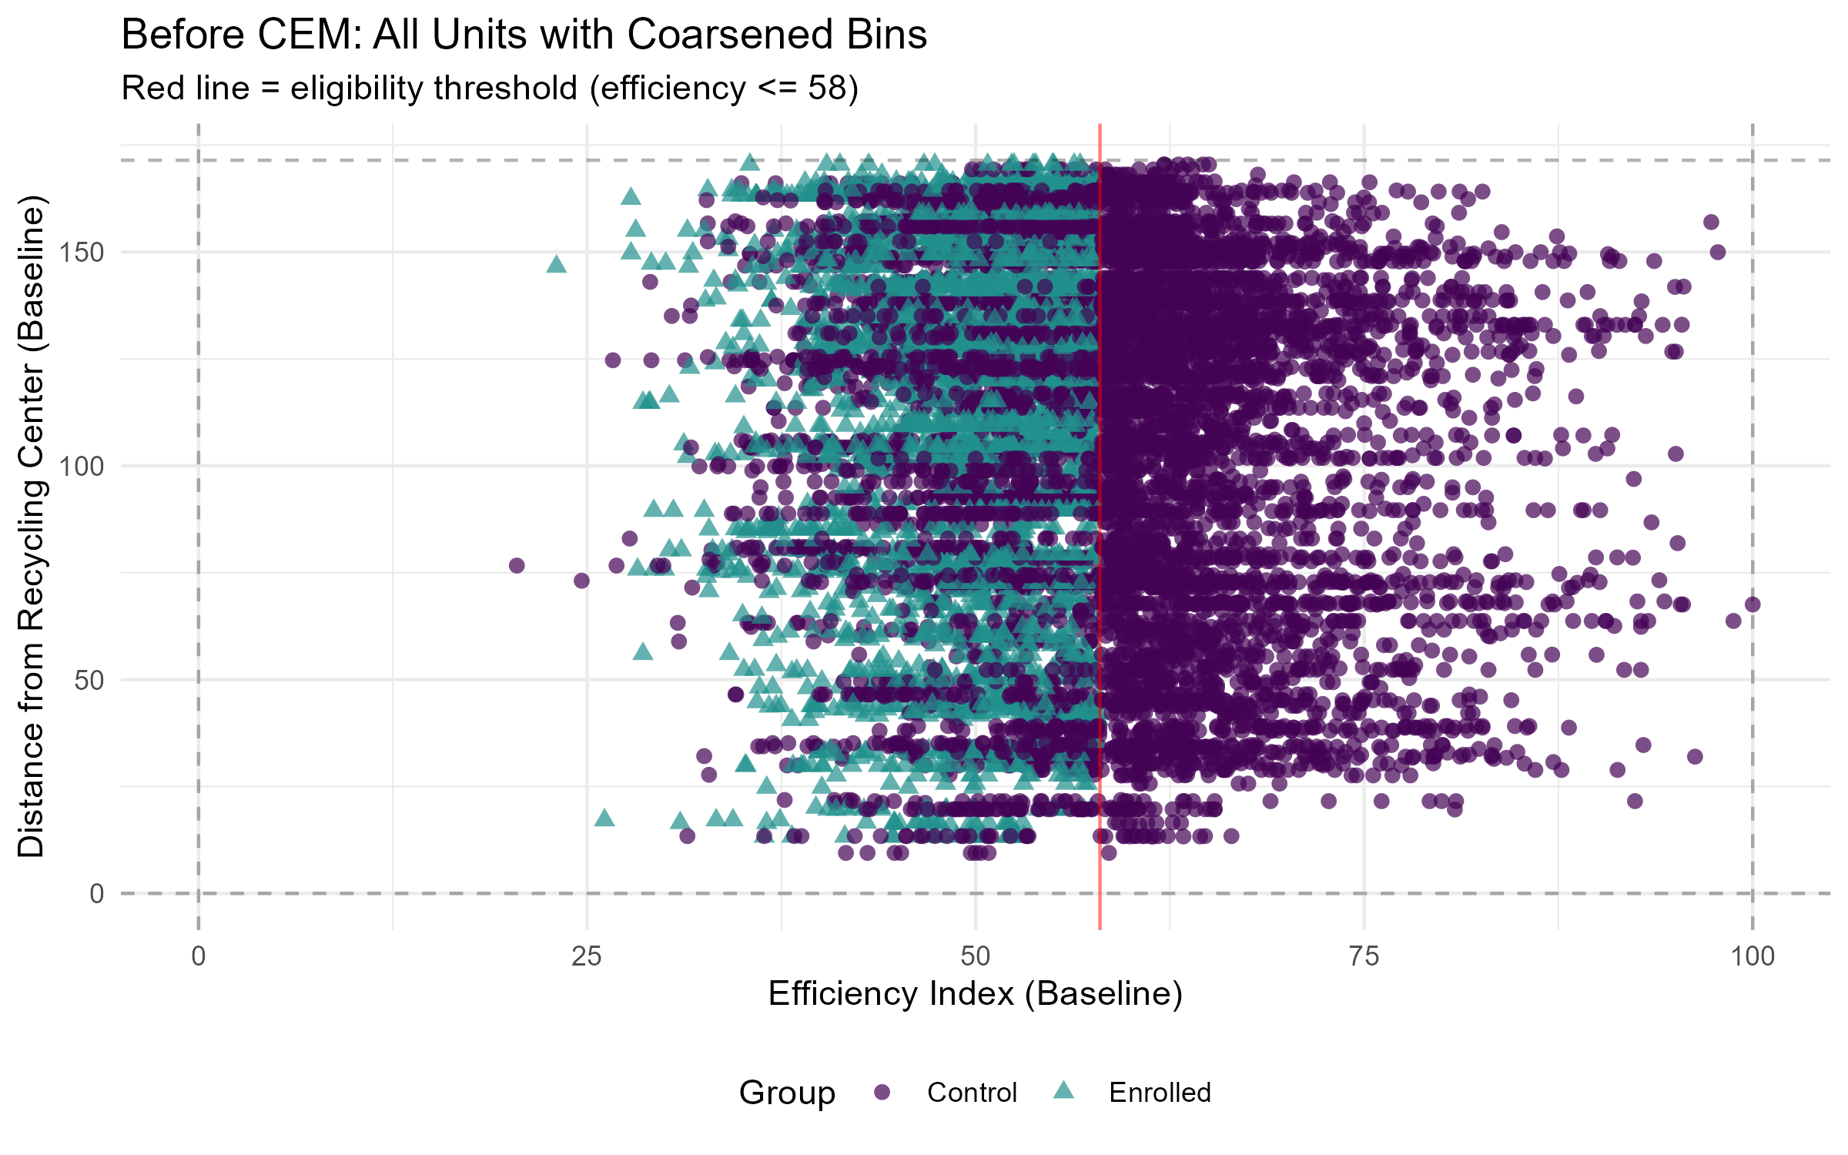
CEM: Before Matching

Slide 57
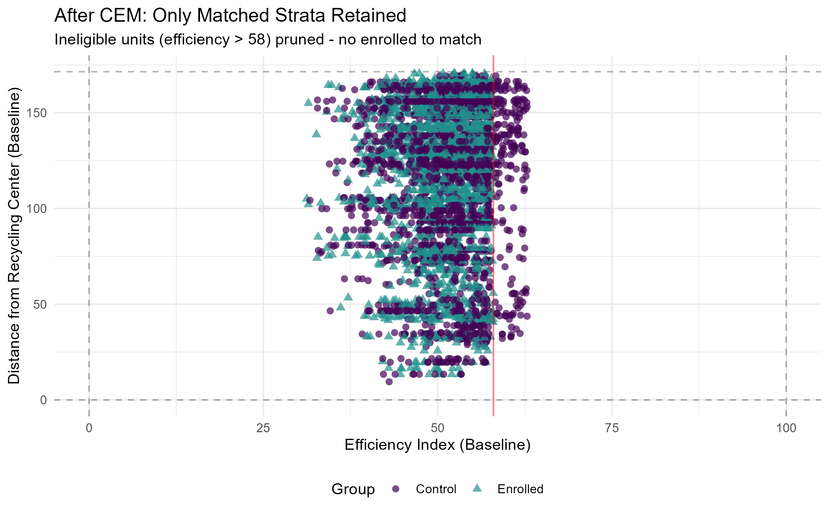
CEM: After Matching

Slide 58
CEM Matching (editable)
 | Limited Covs CEM | All Covs CEM
Matching Effect | -1112.69*** | -987.79***
 | (37.51) | (42.29)
(Intercept) | 1896.67*** | 1794.96***
 | (29.40) | (31.98)
Num.Obs. | 7432 | 3898
+ p < 0.1, * p < 0.05, ** p < 0.01, *** p < 0.001
Standard errors are in parentheses
Matching Regression Results

Slide 60


Each neighborhood has multiple eligible and ineligible businesses (efficiency score<=58)
10 ineligible businesses
10 eligible businesses
Notes:
Each icon represents 10 businesses
Each neighborhood has multiple eligible and ineligible businesses (e.g., X neighborhood has __ eligible businesses)
The program is only available to those in treatment neighborhoods (blue) that are also eligible (those with an efficacy score<58).

Slide 61
Eligible in treat vs eligible in control (RCT)
Notes:
Each icon represents 10 businesses
Each neighborhood has multiple eligible and ineligible businesses (e.g., X neighborhood has __ eligible businesses)
The program is only available to those in treatment neighborhoods (blue) that are also eligible (those with an efficacy score<58).

Slide 62
Background with IV
Emirate (N=9913)
100 Treatment Neighborhoods (N=4959)
100 Control Neighborhoods (N=4954)
Eligible Businesses (N=2964)
Ineligible Businesses (N=1995)
Eligible Businesses (N=2664)
Ineligible Businesses (N=2290)
Decide to enroll (N=2907)
Decide not to enroll (N=57)
Note: (N=number of businesses). Eligible businesses are those with efficiency_index<=58.

Slide 63
Instrumental Variables (IV)

Slide 64


Eligible businesses in treatment neighborhoods can choose whether to enroll (imperfect compliance)
1 eligible business that chooses NOT to enroll
1 eligible business that chooses to enroll
Notes:
Of all the eligible businesses, the program is only available to those in treatment neighborhoods (blue) that are also eligible
For example, X neighborhood has 30 eligible businesses, 20 non-eligible
29 of those that are eligible choose to enroll, 1 eligible chooses not to enroll

Slide 65
Compare actually enrolled vs. not enrolled (ToT)
Total businesses eligible across all neighborhoods | 5,628
Total eligible businesses in treatment neighborhoods | 2,964
Total businesses that are eligible in treatment neighborhood and choose NOT to enroll | 57
Total businesses that are eligible in treatment neighborhood and choose to enroll | 2,907

Slide 66
Eligible businesses in treatment neighborhoods can choose whether to enroll (imperfect compliance)
1 eligible business that chooses NOT to enroll
1 eligible business that chooses to enroll
Notes:
Of all the eligible businesses, the program is only available to those in treatment neighborhoods (blue) that are also eligible
For example, X neighborhood has 30 eligible businesses, 20 non-eligible
29 of those that are eligible choose to enroll, 1 eligible chooses not to enroll

Slide 67
Compare actually enrolled vs. not enrolled (ToT)
Total businesses eligible across all neighborhoods | 5,628
Total eligible businesses in treatment neighborhoods | 2,964
Total businesses that are eligible in treatment neighborhood and choose NOT to enroll | 57
Total businesses that are eligible in treatment neighborhood and choose to enroll | 2,907

Slide 68
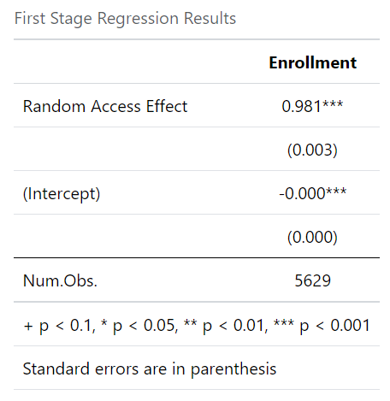
IV: First Stage

Slide 69
IV: First Stage (editable)
 | Enrollment
Random Access Effect | 0.98***
 | (0.00)
(Intercept) | -0.00***
 | (0.00)
Num.Obs. | 5628
+ p < 0.1, * p < 0.05, ** p < 0.01, *** p < 0.001
Standard errors are in parentheses
First Stage Regression Results

Slide 70
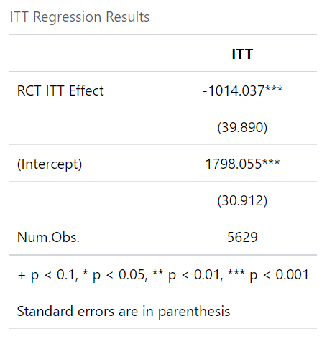
IV: ITT
Notes:
The second stage is the link between participation on our outcomes of interest. This second stage is the effect of the *encouragement* on the outcome (referred to as the “reduced form”). This is also known as the Intention-to-Treat (ITT) Effect or the effect on outcomes based on the original randomization, regardless of the actual treatment or compliance with the program.
ITT Results: - Promotion directly reduces waste management costs by ___. This is the policy-relevant effect of offering promotion, but it underestimates the effect on those who actually enroll

Slide 71
IV: ITT (editable)
 | ITT
RCT ITT Effect | -1014.08***
 | (39.89)
(Intercept) | 1798.06***
 | (30.91)
Num.Obs. | 5628
+ p < 0.1, * p < 0.05, ** p < 0.01, *** p < 0.001
Standard errors are in parentheses
ITT Regression Results

Slide 72
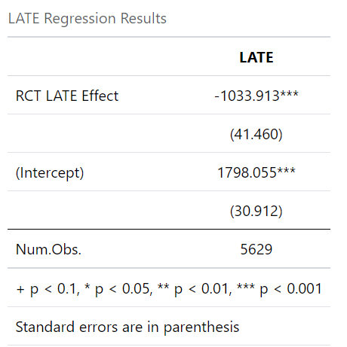
IV: LATE
Notes:
We still don’t know the effect of the participation on outcomes, which is what we want. To get the estimate of interest (effect of participation on outcomes), we need to divide the “reduced form” (the effect of encouragement on outcomes) by the first stage (effect of encouragement on participation).
Ultimately, we are able to isolate the effect of the program, by using the instrument. What we have now is called the LATE (local average treatment effect) – we have an estimate of an impact that is attributable to the program for those who complied with the promotion
This estimates the effect for "compliers": industries that enrolled because of the promotion but would not have enrolled otherwise

Slide 73
IV: LATE (editable)
 | LATE
RCT LATE Effect | -1033.96***
 | (41.46)
(Intercept) | 1798.06***
 | (30.91)
Num.Obs. | 5628
+ p < 0.1, * p < 0.05, ** p < 0.01, *** p < 0.001
Standard errors are in parentheses

